Slide 1


WOSA
CAP CLASSIQUE
Uniquely South African

Slide 2
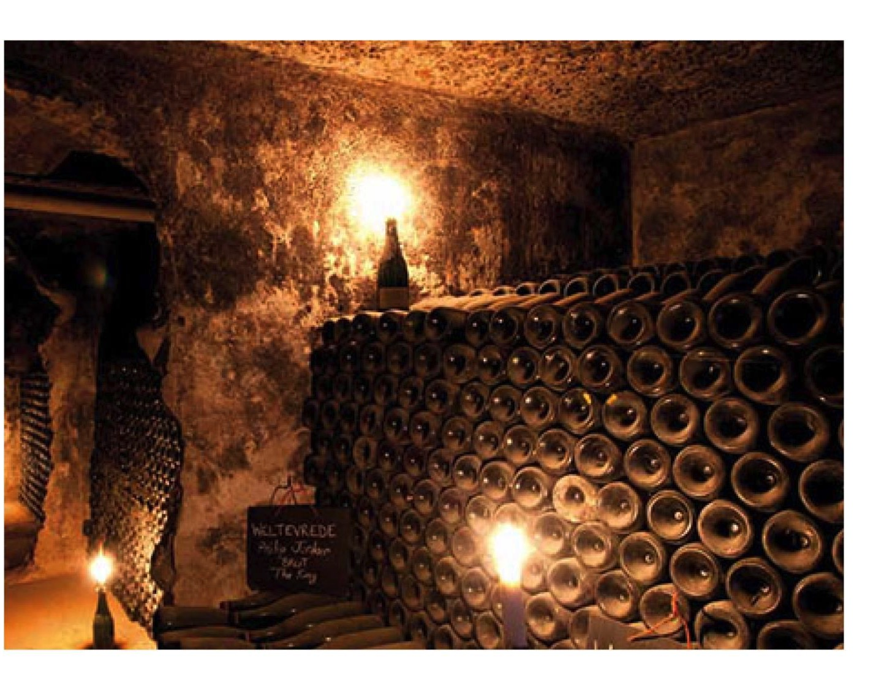
WOSA
Notes:
Under an agreement with France, South Africa has never had any reference to Champagne and the term Méthode Champenoise, which describes the sparkling wines produced in the Champagne area, has no longer been used since 1992. Instead, we have our own unique term to outline the production method: Cap Classique. We follow the exact same process – once the base wine has been bottled, the bottles ferment and mature horizontally in cool, dark cellars for a minimum of 12 months. There are some producers who ensure much longer yeast contact time, depending on the style and vintage.

Slide 3
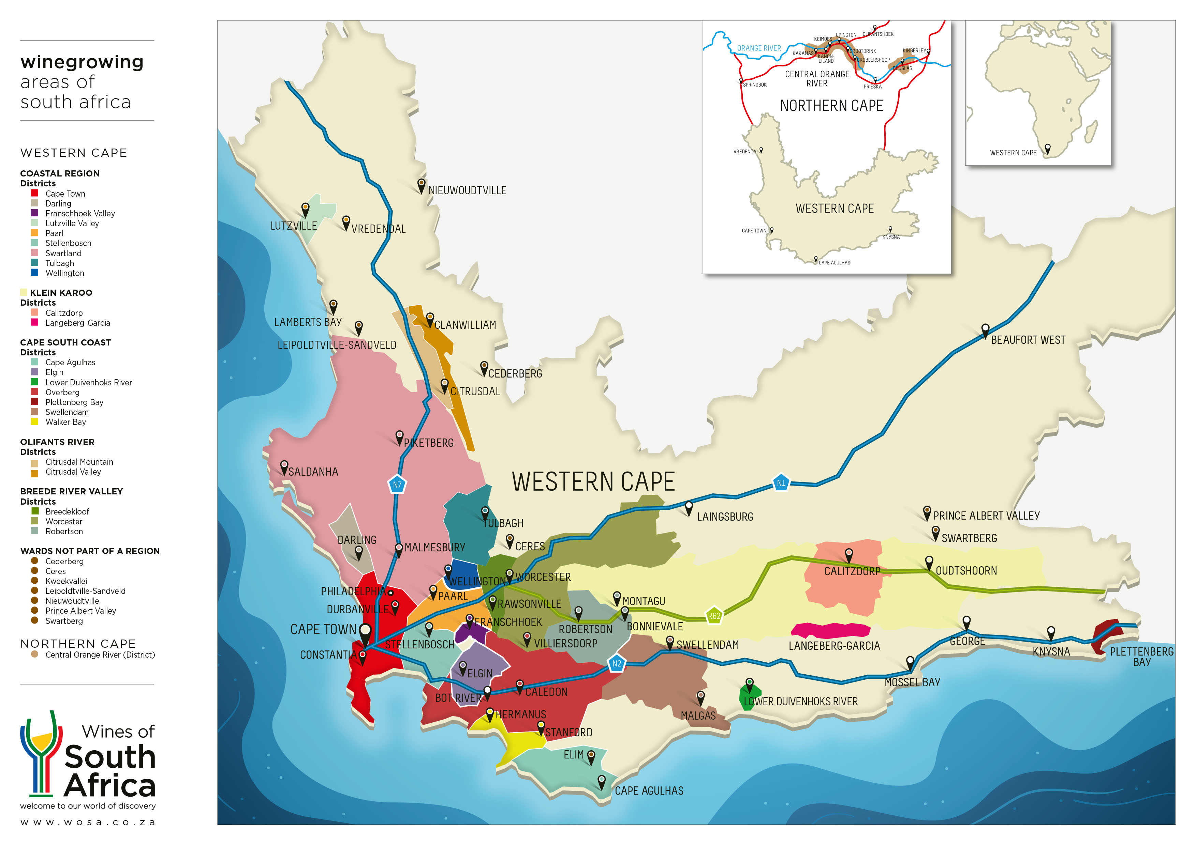
WOSA
Notes:
Approximately 11 million bottles of Cap Classique are produced annually across 32 geographical areas with Stellenbosch, Paarl and Robertson being the three most prominent areas.

Slide 4
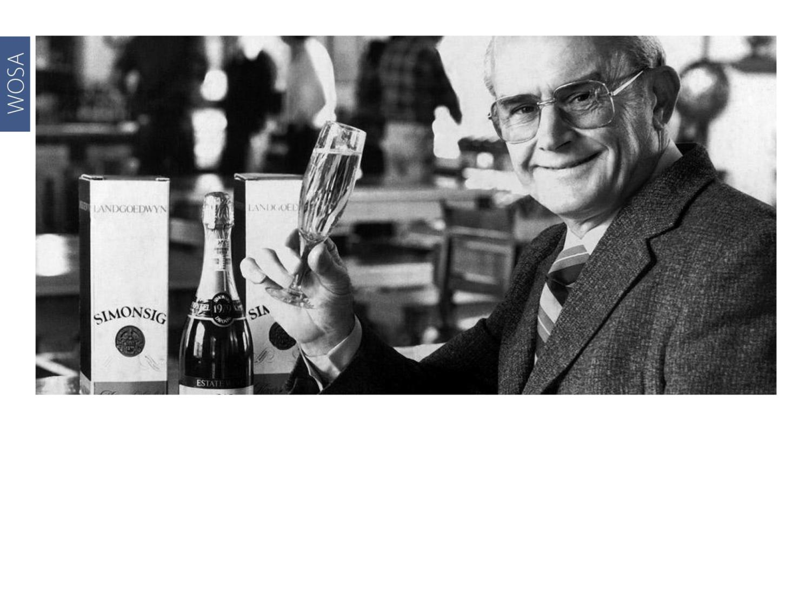
WOSA
Notes:
In 1971, the first bottle-fermented sparkling wine in South Africa was produced by Frans Malan of Simonsig and called Kaapse Vonkel (Cape Sparkle). The maiden vintage was made mainly from Chenin Blanc.

Slide 5
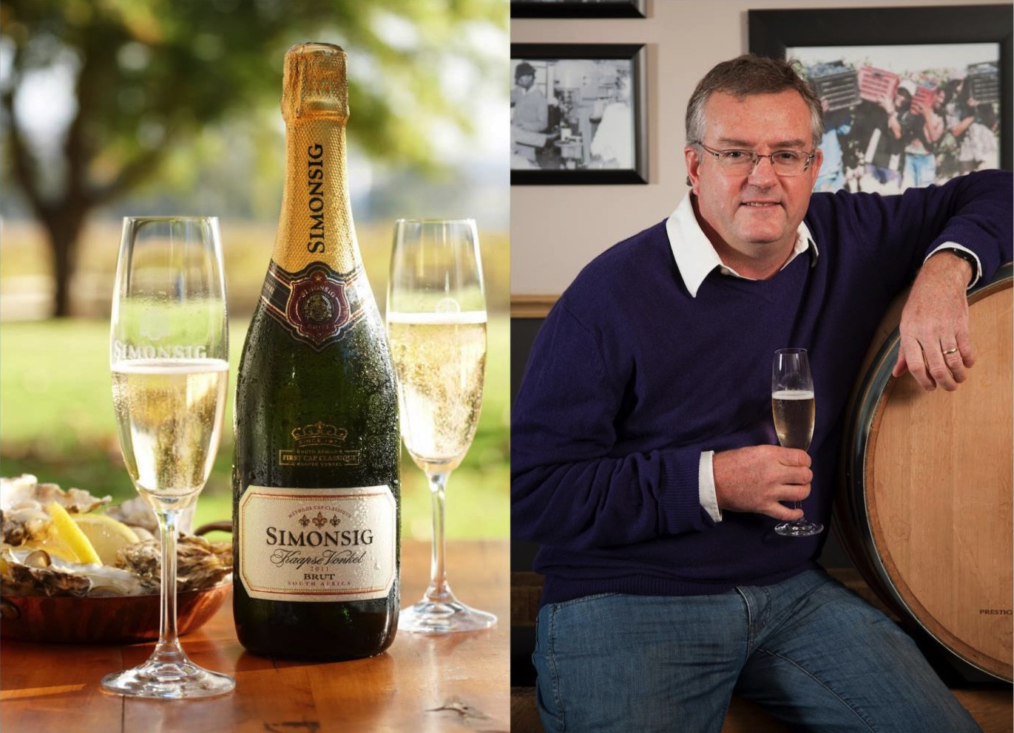
WOSA
Notes:
The first commercial amount of Pinot Meunier in the Cape was planted by his son Johan Malan at Simonsig.

Slide 6
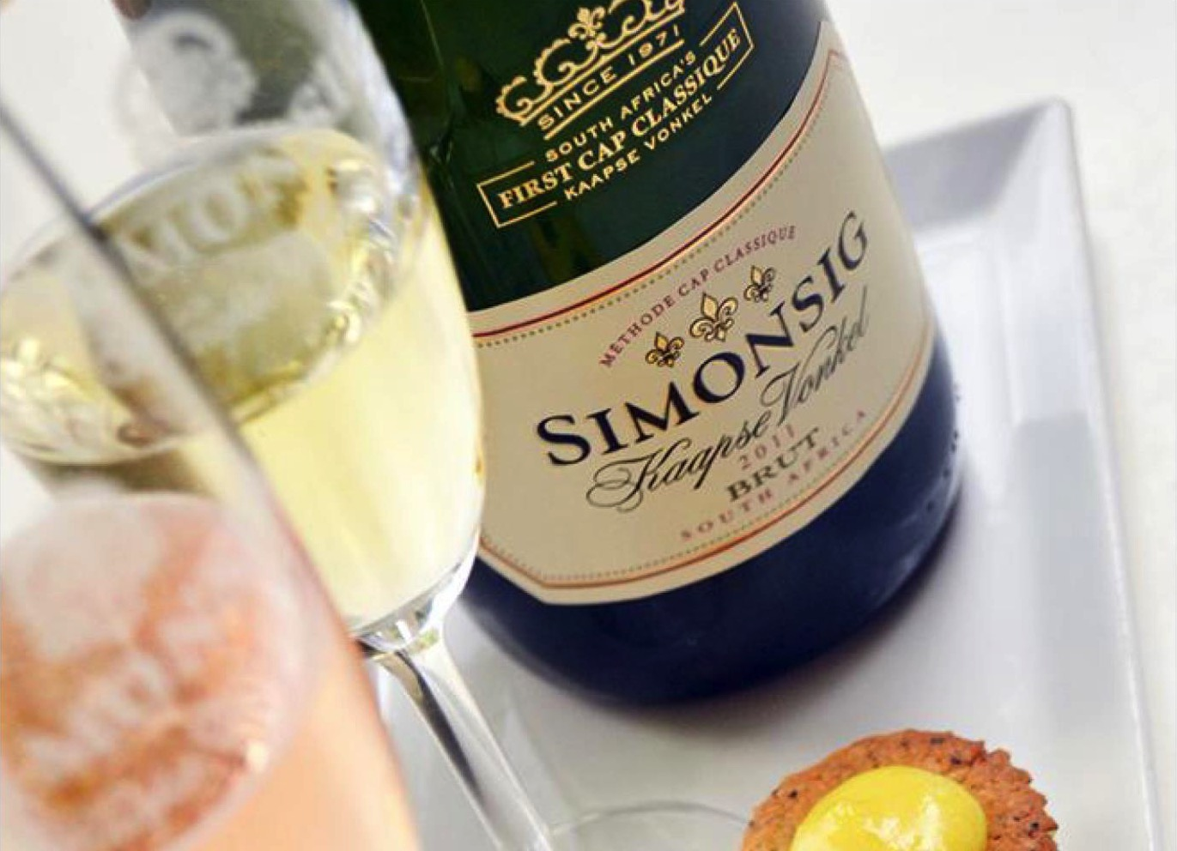
WOSA
Notes:
Kaapse Vonkel later became the first Cap Classique in the winelands to contain all three of the classic varieties that are used in Champagne. Today, there are more of these examples in the market.

Slide 7
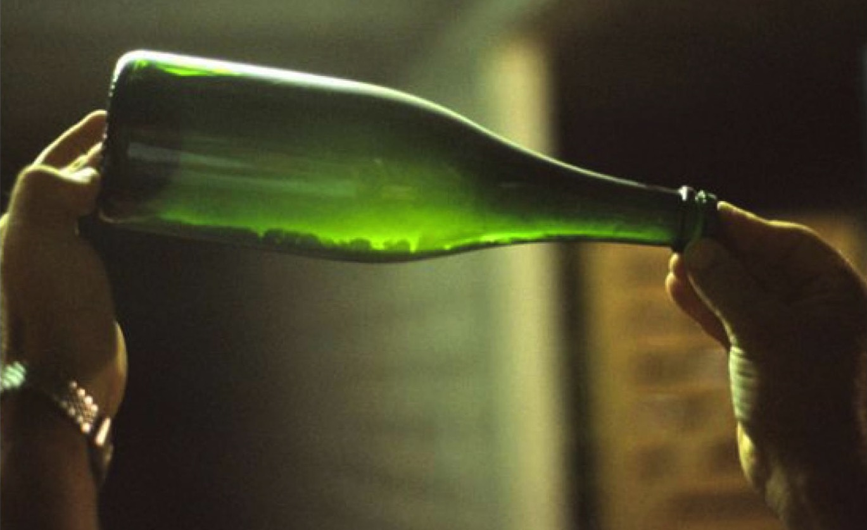
WOSA
Notes:
Originally, 14 like-minded producers got together to establish the Cap Classique Producers Association (CCPA) in 1992. The association currently has over 100 active members. Not all Cap Classique is made by its members and the CCPA strives to get support and buy-in from all. Their vision is to promote South Africa’s premium Cap Classique wines, as well as the common interests of the producers. Today, the CCPA members are responsible for 90% of all Cap Classique produced in South Africa. Visit www.capclassique.co.za for more information.

Slide 8
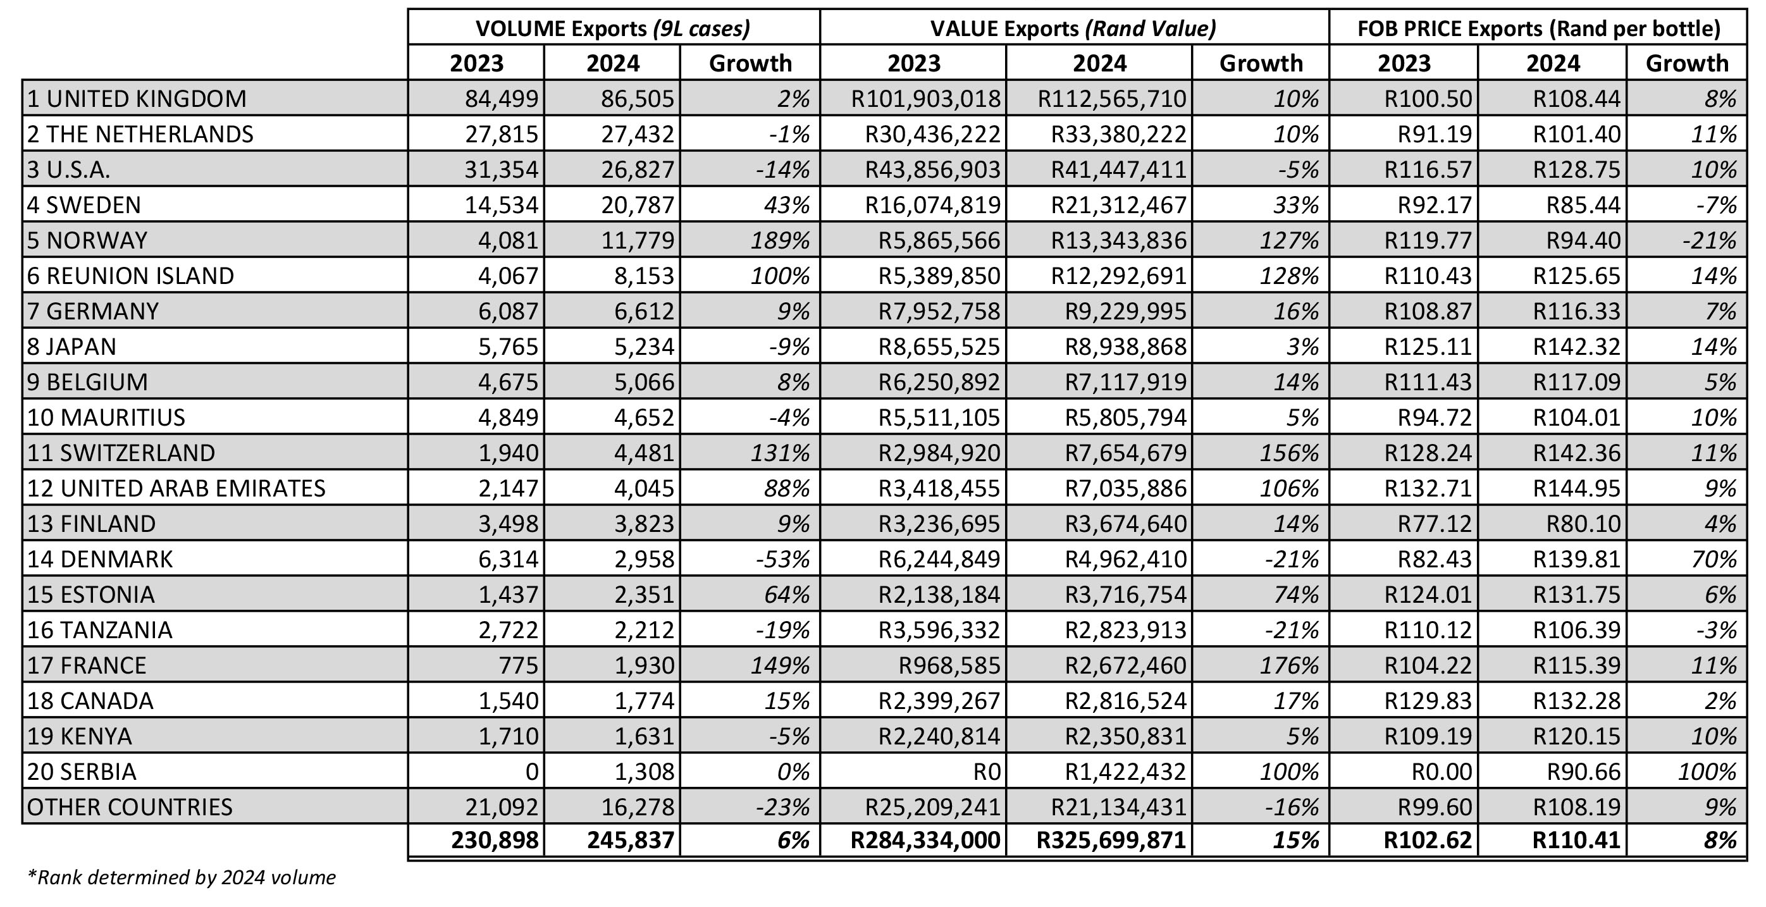
Top 20 South African Cap Classique
Export Markets
Rolling Shipments (1 Jul–30 Jun 2024 vs 2023)
WOSA

Slide 9
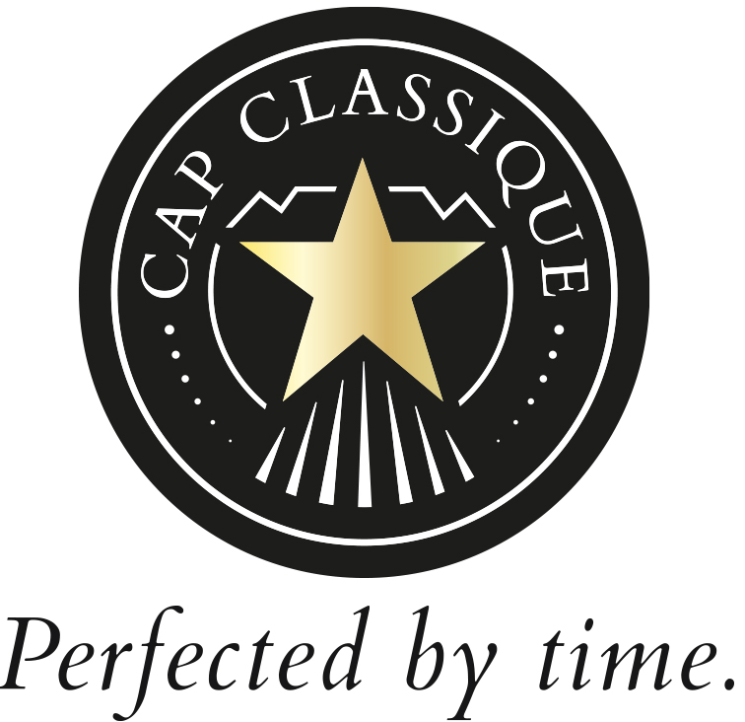

Slide 10
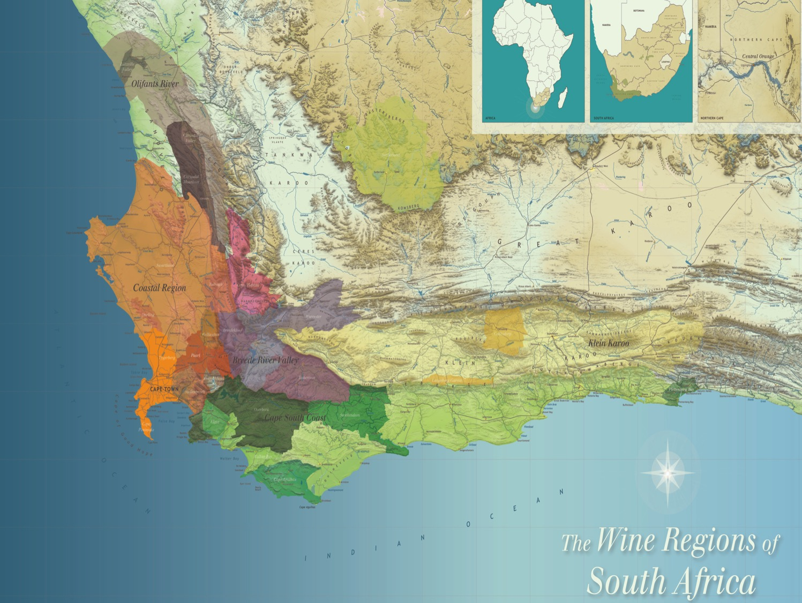
Notes:
Diversity and geographical differences add to the assortment of Cap Classiques.

Slide 11
Vinification
Vinification of Cap Classique is not controlled, but whole bunch pressing is preferred and recommended.
The use of stainless steel and wooden barrels is permitted. As from June 2021, the legal minimum time on the lees is 12 months, but many producers allow their wines longer on the lees.
Other regulations for Cap Classique are that the bottle needs to be a minimum of three bars of pressure and that the same bottle as the wine was fermented in goes to market.
WOSA

Slide 12
Styles
Cap Classique could be vintage dated or non-vintage. (Vintage dated
Cap Classique was not given a separate category, as a large proportion of the wines are bottled with a vintage date, regardless of the quality of the wine.) Vintage therefore is not a quality guarantee.
Different styles:
  Blanc de Blancs is made only from white grapes.
  Blanc de Noir is made only from red grapes.
  Normal blends (white predominant or vice versa)
  Rosé also has its own category.
  Prestige/Icon – Normally expressing extended lees contact time (three years +) indicating ultra-premium.
A big development is the so-called Nectar category that originated from Demi-Sec. This category ranges from 20g/l to 40g/l and the reference on the label is Nectar (no prescribed sugar reference). Demi-Sec still
adheres to the OIV regulation.
WOSA

Slide 13
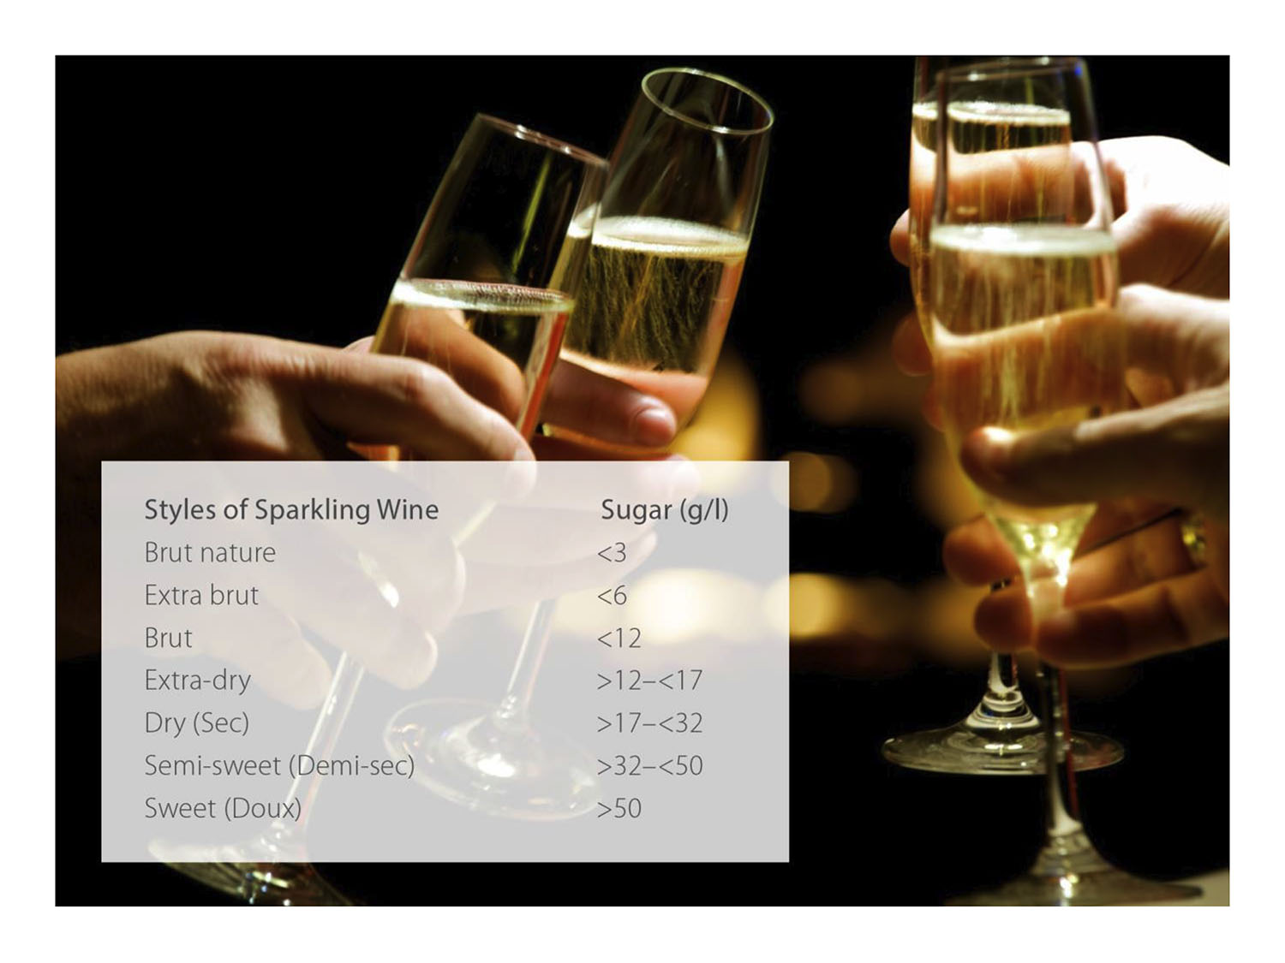
WOSA

Slide 14
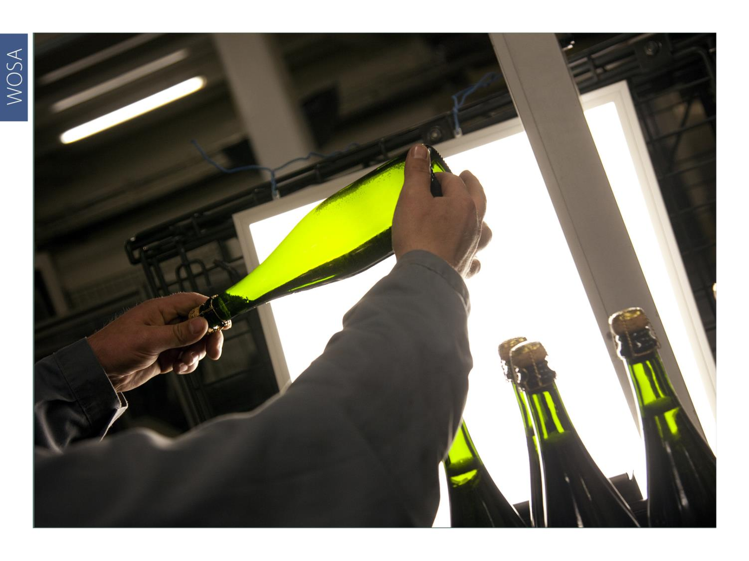
WOSA
Notes:
There are quality standards that all producers adhere to voluntarily, apart from the minimum time on the lees (12 months) and the bars of pressure, which are mandatory in order to use the term Cap Classique on the label.

Slide 15
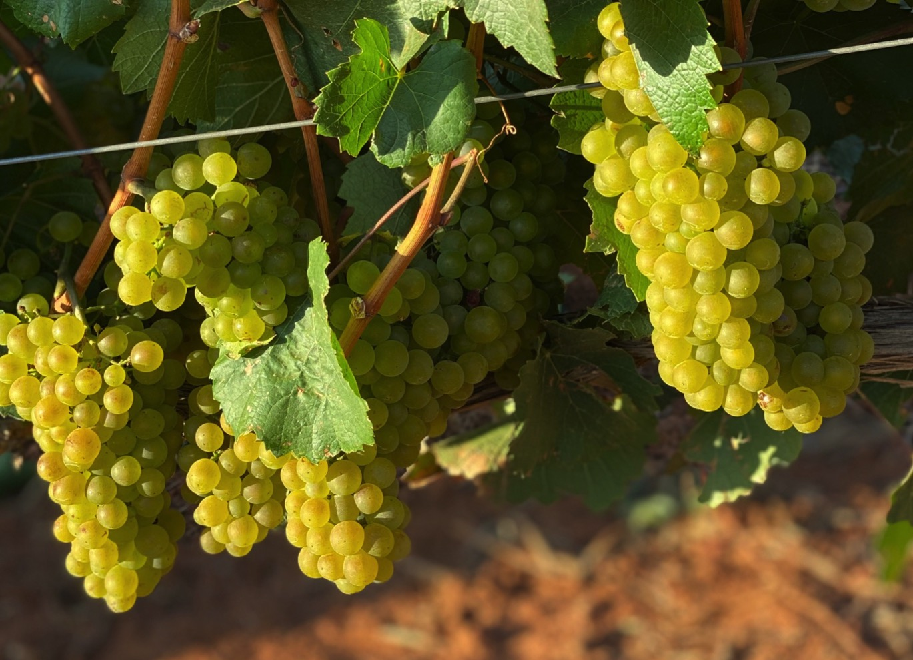
WOSA
Notes:
Predominantly Chardonnay and Pinot Noir, both natives of Burgundy in France, are used for Cap Classique.

Slide 16
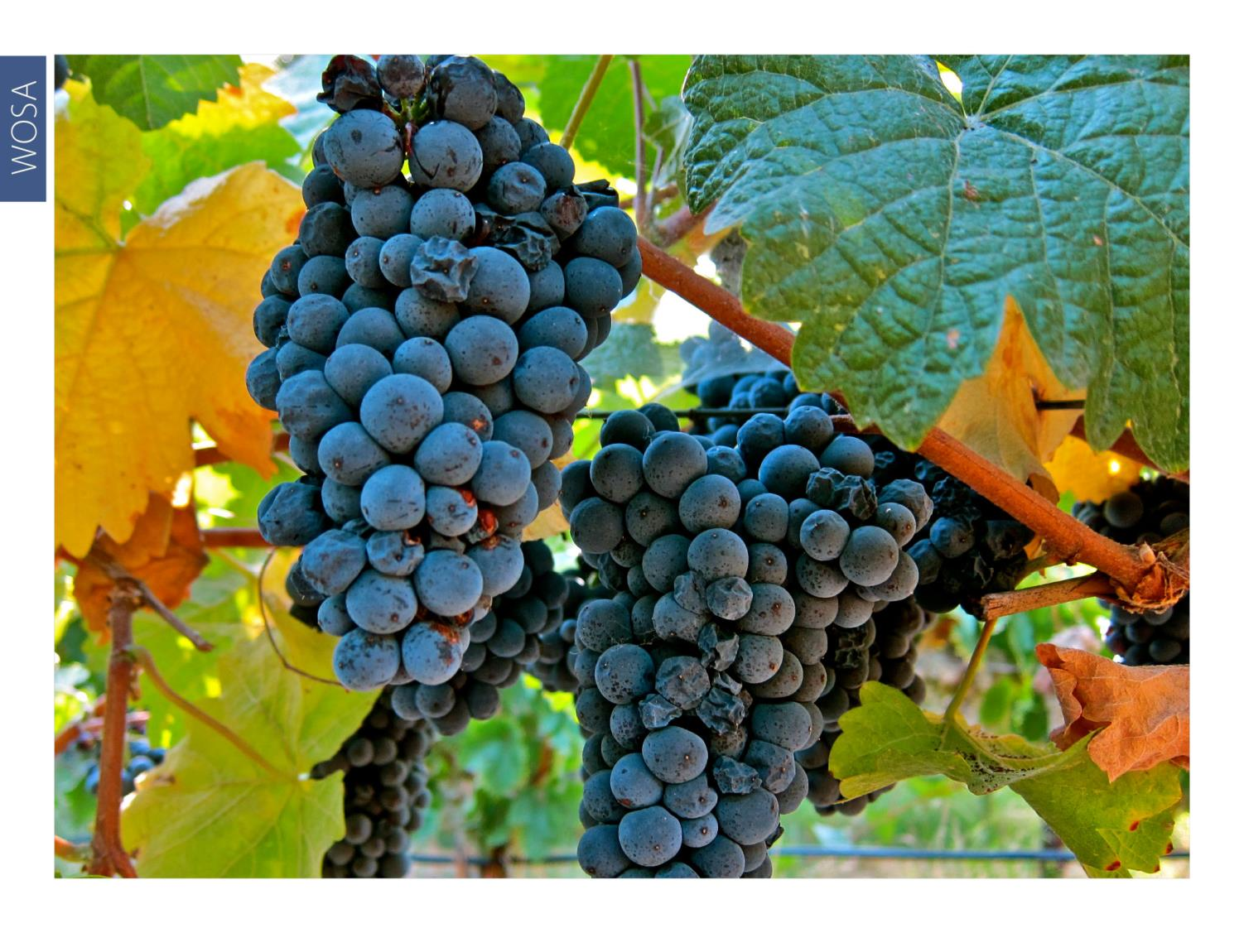
WOSA
Notes:
Pinot Meunier, also traditionally used in Champagne, is also used in Cap Classique. A member of the Pinot family, it is more productive than its sibling Pinot Noir, and the resultant base wines are fruity and aromatic.

Slide 17
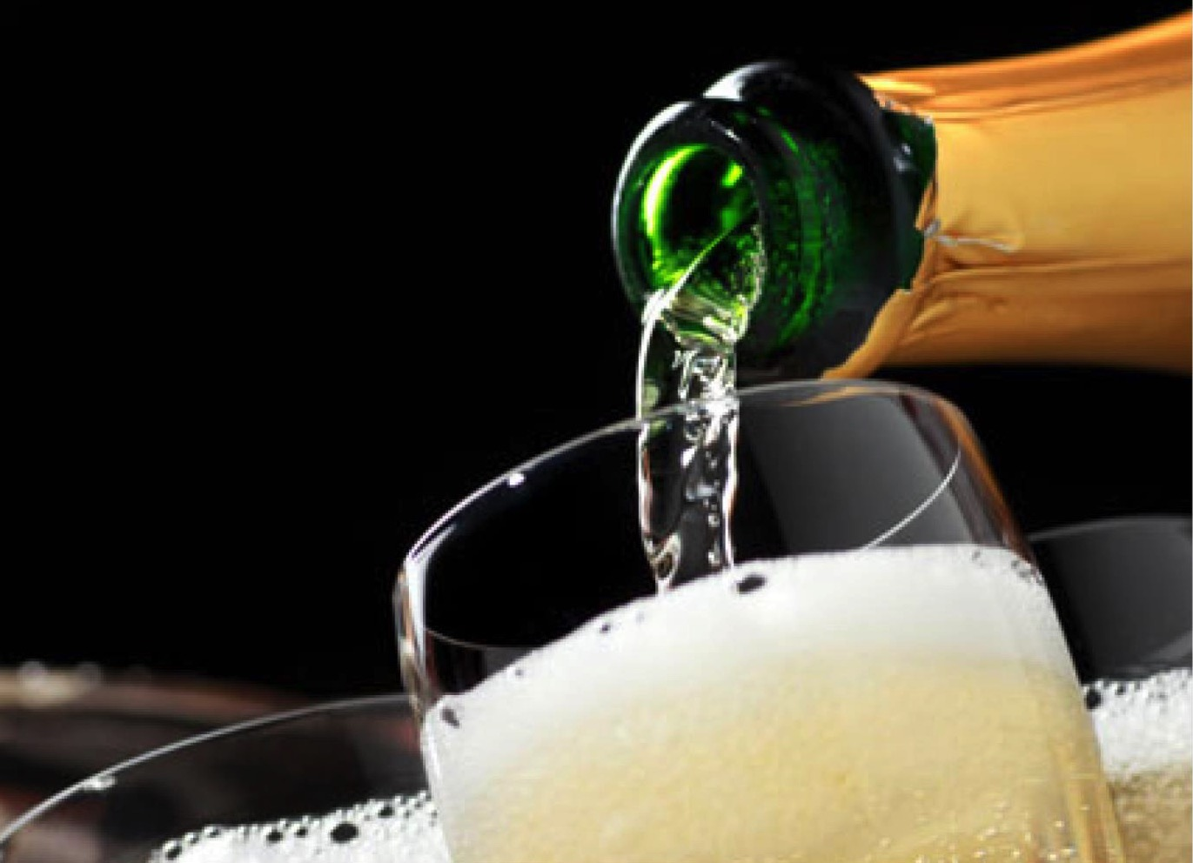
WOSA
Notes:
Various other grape varieties are also used in the production of Cap Classique, from Chenin Blanc to Sauvignon Blanc, and even Pinotage and Shiraz!

Slide 18
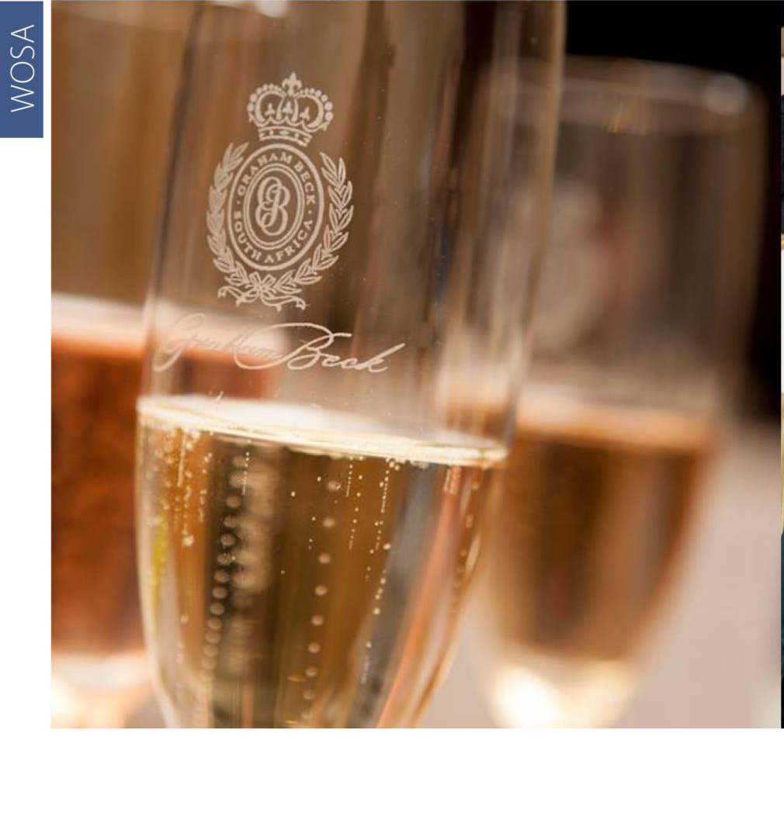
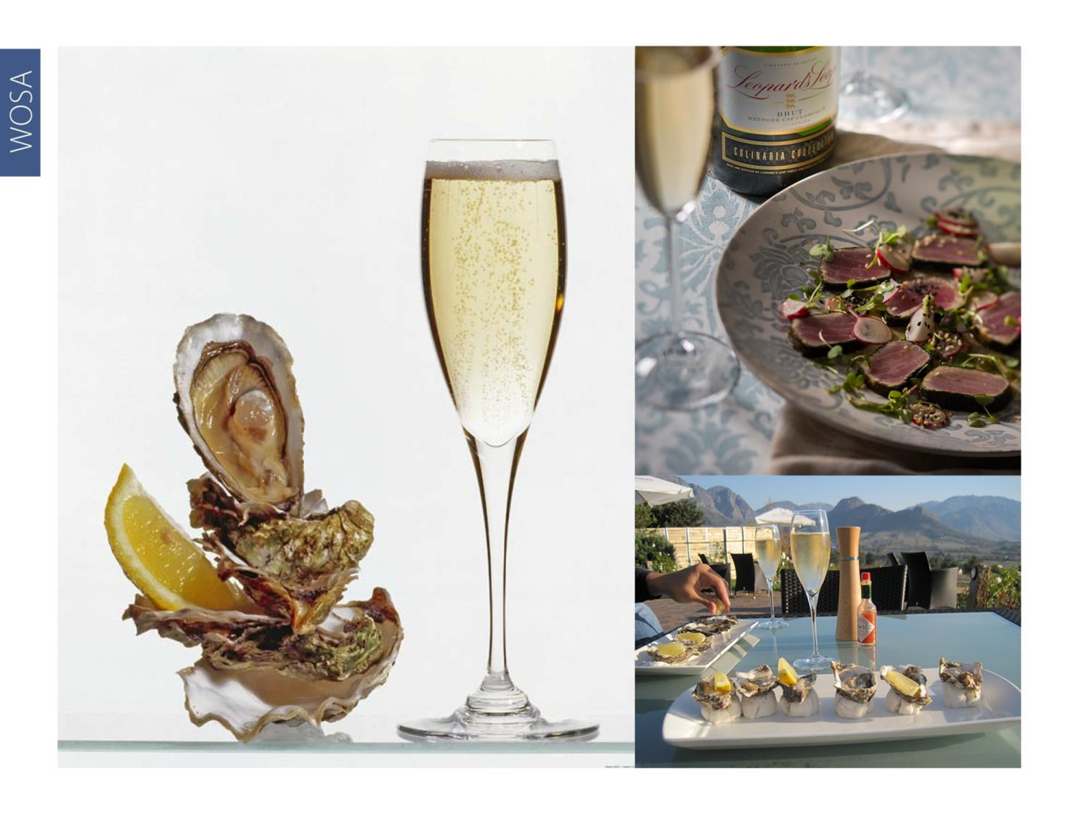
WOSA
Notes:
Today, South African Cap Classiques have achieved international accolades and recognition. They have also been selected to toast some defining moment in history. For example, Graham Beck Brut was selected for the inauguration of the country’s first democratically elected president, Nelson Mandela, in 1994 and when Barack Obama was declared nominee of the Democratic Party for the 2008 US presidential election.

Slide 19
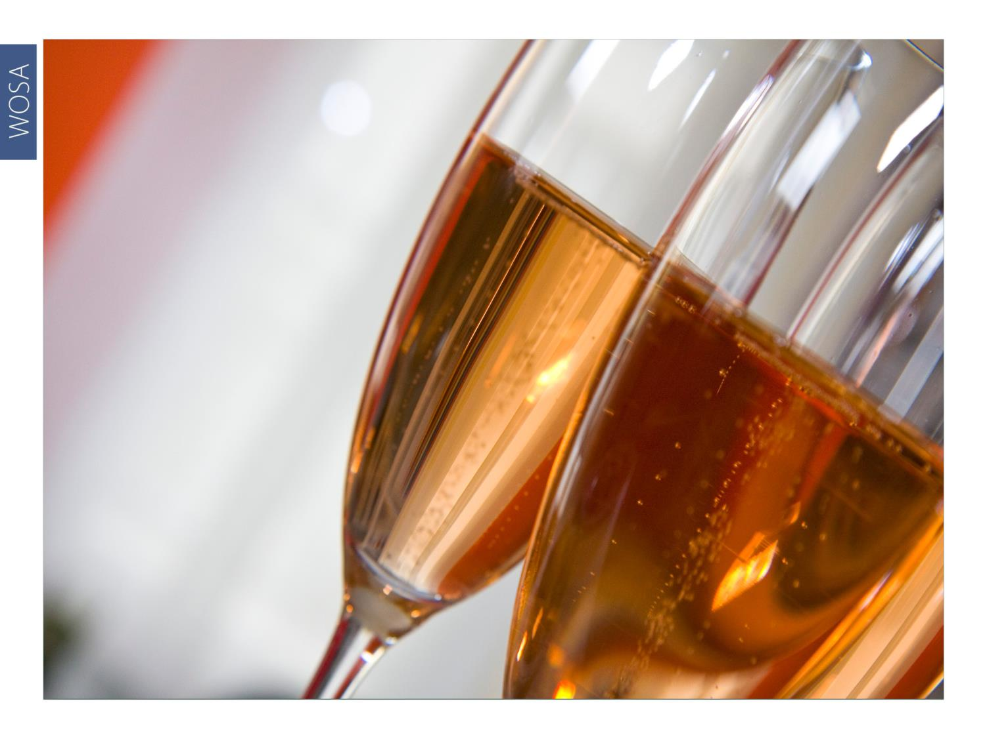
WOSA
Notes:
Cap Classique Rosés can be made from a classic combination of Pinot Noir and Chardonnay, sometimes co-pressed or co-fermented, or a number of red-grape varieties, from the traditional Pinot Noir and Pinot Meunier to proudly South African Pinotage. Skin contact and the addition of red wine is permissible.

Slide 20
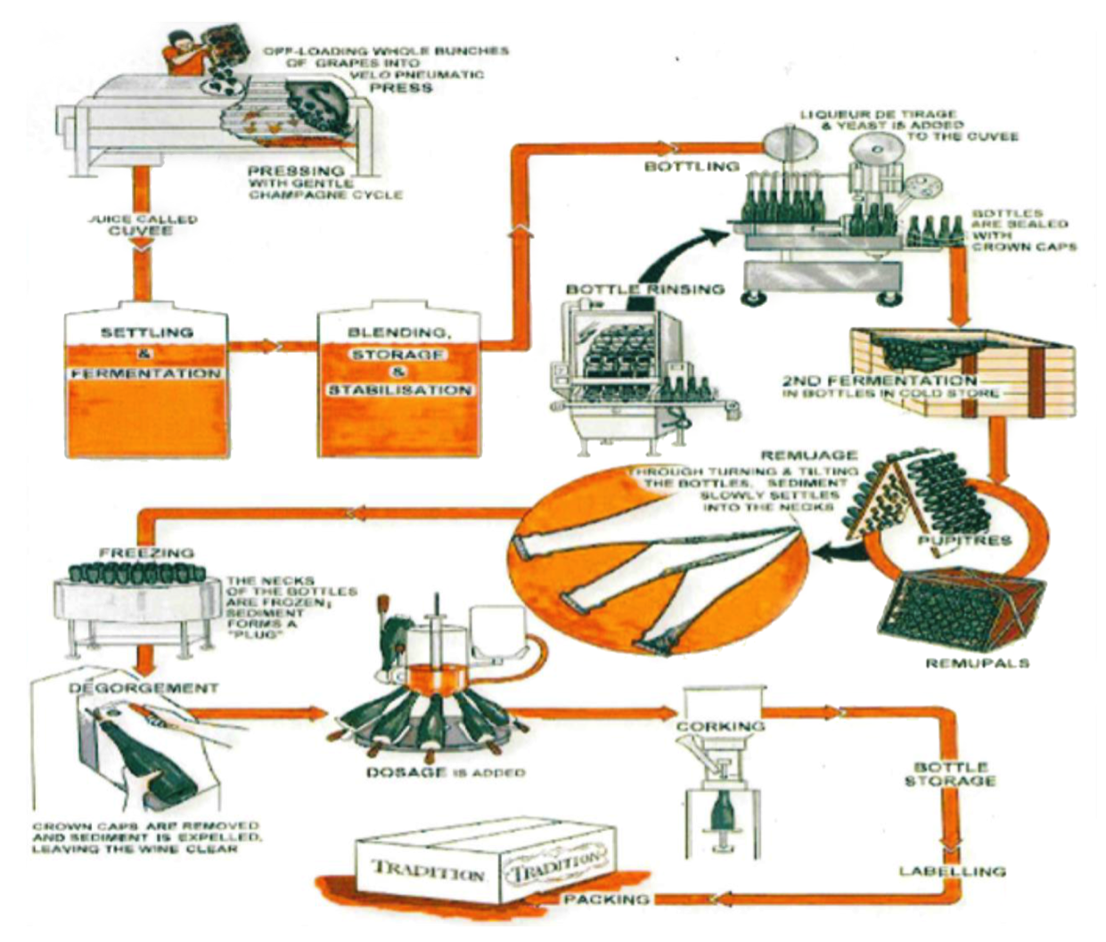
WOSA
Notes:
Whole bunch pressing is at the heart of the winemaking process, with only the first pressing (cuvée quality juice) usually used to make the various base wines destined to be called Cap Classique.

Slide 21
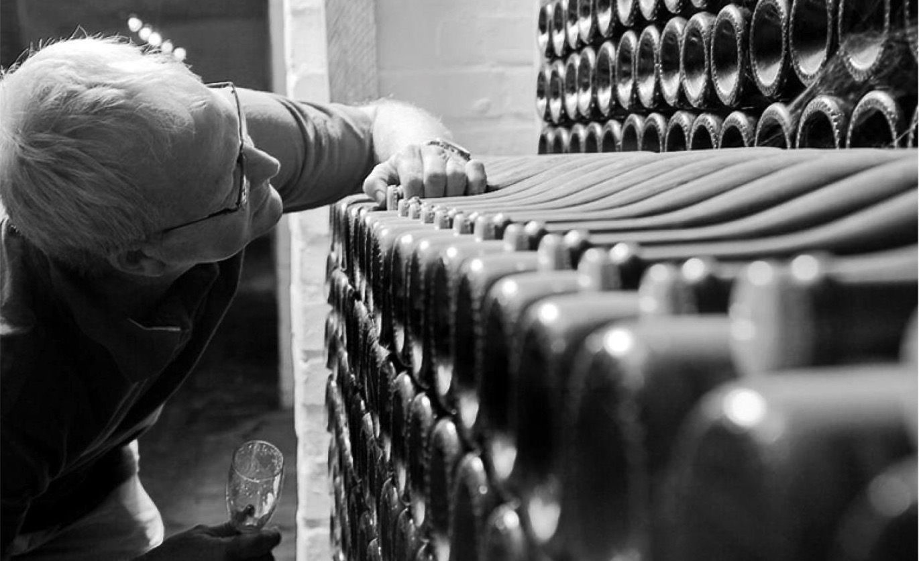
WOSA
Notes:
Individual base wines and blends are tasted annually to ensure that the final wine is of a high quality. Lees contact time is a differentiator.

Slide 22
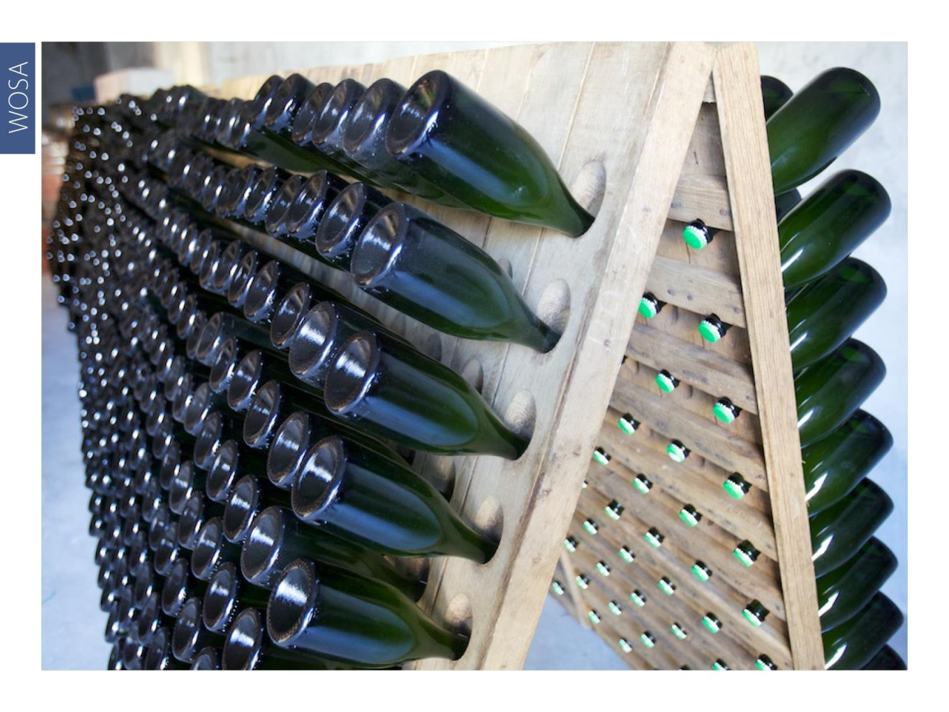
WOSA
Notes:
After riddling and disgorging, Cap Classique wines are left to mature on the cork for some time, to ensure integration and balance. This is done either by hand in pupitre or by automatic gyro-pallets.

Slide 23
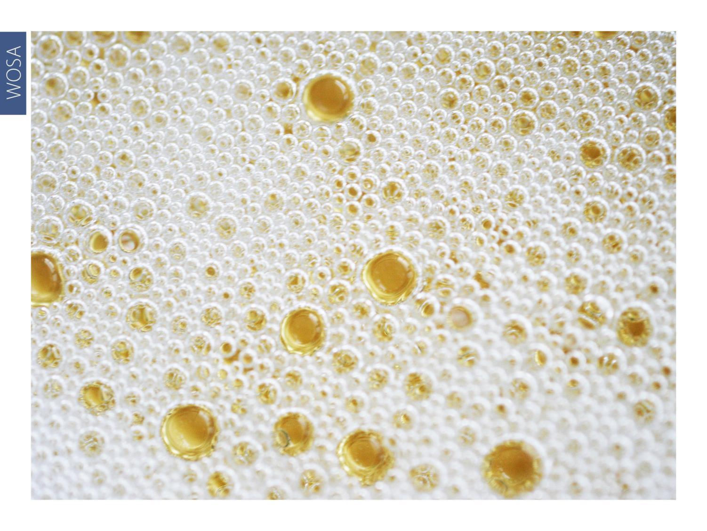
WOSA
Notes:
Cap Classique typically displays pure, clean fruit, while producers on occasion struggle to achieve very great complexity. Cap Classique has, however, become a major category only recently and there is every expectation that the wines will become finer and more intricate as producers gain more experience in bubbly production.

Slide 24
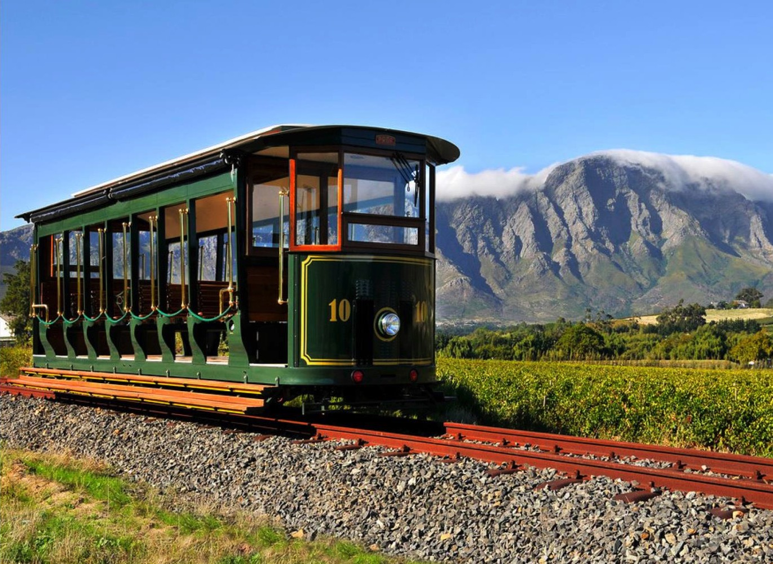
WOSA
Notes:
Grapes are selected from a diversity of regions in the Cape, resulting in highly individual styles. Cap Classique producers are concentrated mainly in Constantia, Franschhoek, which has its own Cap Classique Route, Robertson and Stellenbosch. Wine tourism has become an integral part of the wine offerings at the various producers.

Slide 25
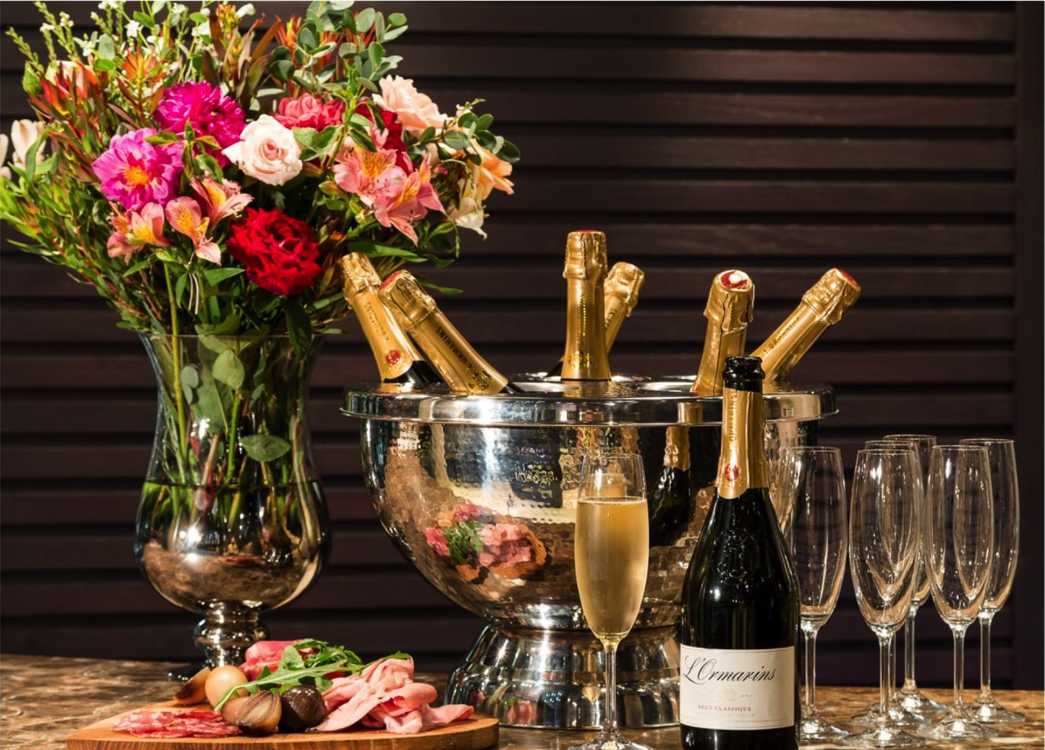
WOSA
Notes:
Flavour profiles range from fresh green apple and citrus hints to almond biscotti and yeasty brioche. Pink-hued Cap Classique Rosés often display red berry characteristics.

Slide 26

WOSA
Notes:
Cap Classique is a natural fit for oysters and as an aperitif with canapés. It also pairs well with fish dishes like sole or salmon with a creamy or buttery sauce and shellfish.

Slide 27
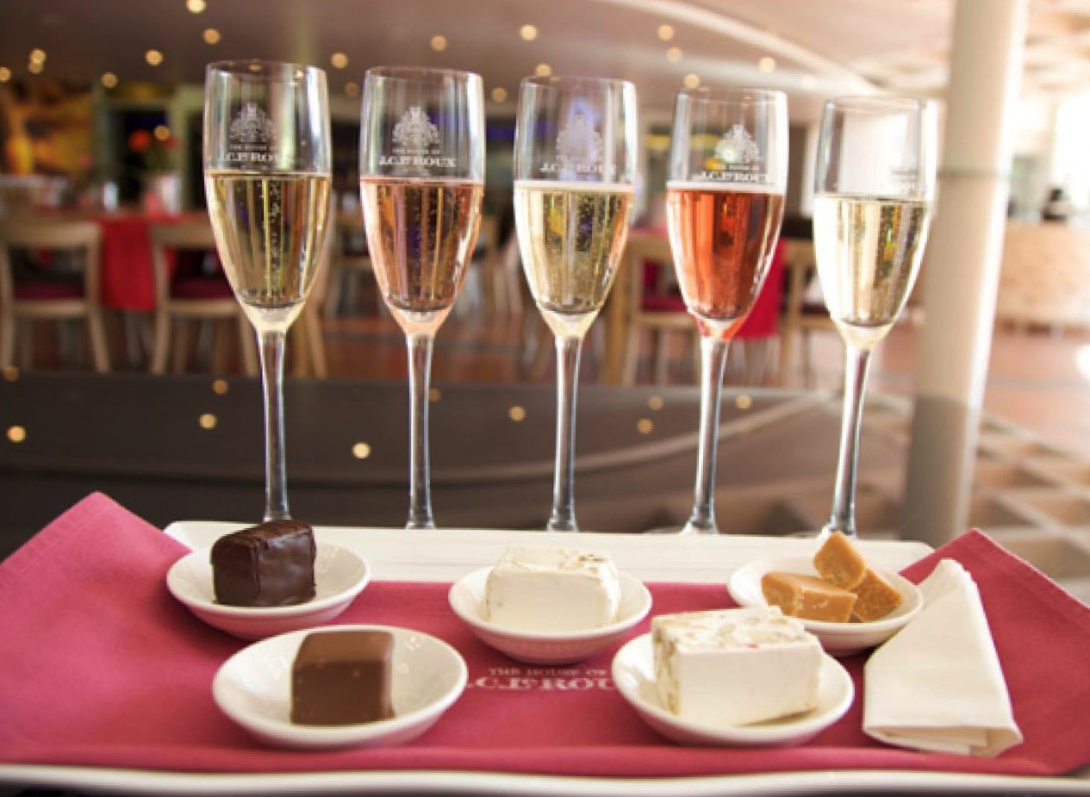
WOSA
Notes:
Cap Classique can also be partnered with dessert, as well as nougat or handmade Turkish delight.

Slide 28
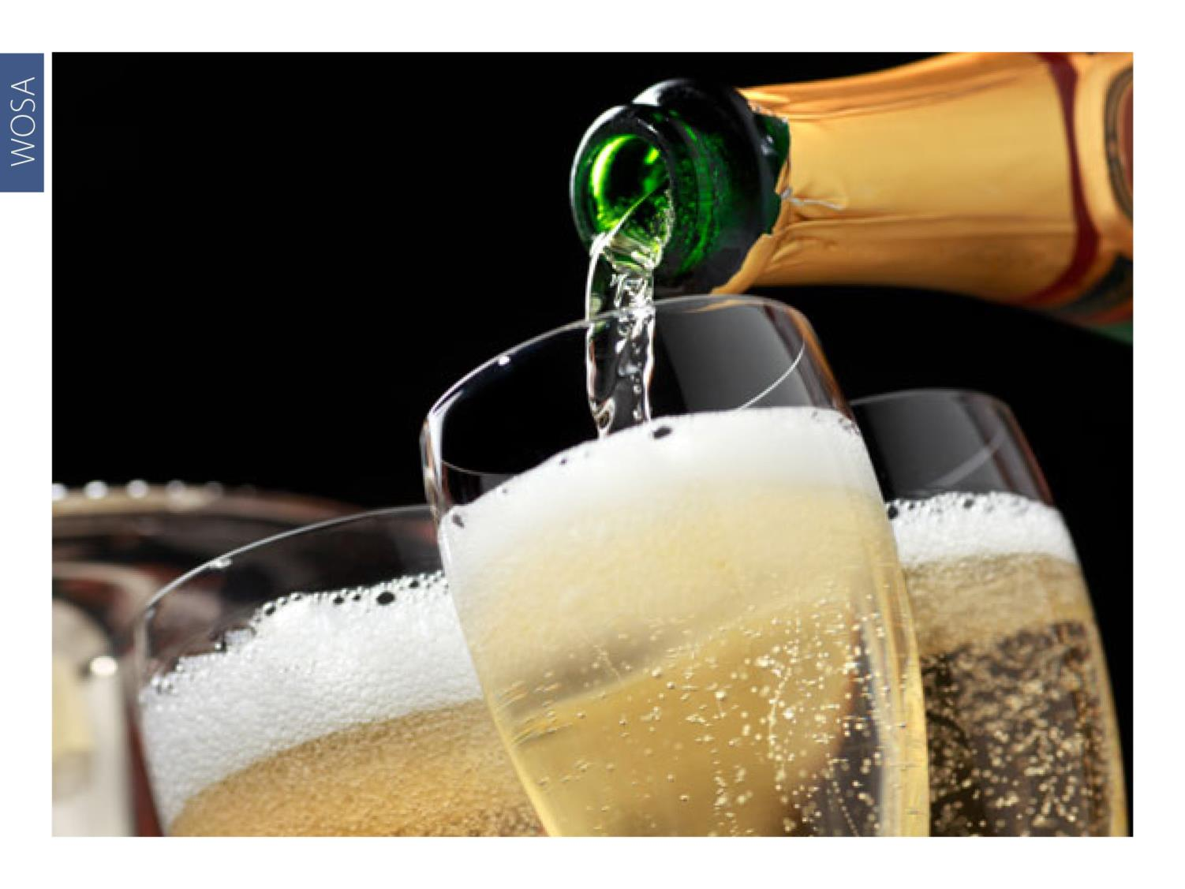
WOSA
Notes:
Cap Classique is a great palate cleanser between tasting wines and it refreshes the mouth after eating strong-flavoured foods. It is also perfect for celebrating a special occasion and a great way to end an evening.

Slide 29
WOSA
“Cap Classique volumes are doubling every 4.5 years,
making it one of the most exciting categories in the
South African wine industry.”
– Pieter Ferreira, COO at Graham Beck and chairman of the Cap Classique Producers Association

Slide 30

WOSA
THE END

